Slide 1

Project: Conversation Dialogue Identification
York University – CSML1010 – Final Project – Group 3: Jerry Khidaroo, Paul Doucet
Instructor: Dr. Annie En-Shiun Lee

Slide 2
Final Project: Machine Learning Life-cycle
Introduction
Existing Work
Methodology
Results
Discussion
Conclusion
References/Bibliography

Slide 3
Introduction
Methodology
Results
Discussion
Conclusion
Project Definition
Existing Work
Project Definition: Conversation Identification
The problem we will examine is a supervised multi-class text classification problem.
Goal: The goal is to investigate which supervised machine learning methods will give the best results in classifying the texts from our dataset into the pre-defined categories.
Input: conversation dialogue text and labels Output: model that predicts the “instruction_id” category correctly
Input
Conversation Dialogue text and labels
Machine Learning
Machine Learning Steps
Output
Model that predicts the “instruction_id” category

Slide 4
Introduction
Methodology
Results
Discussion
Conclusion
Project Definition
Existing Work
Type | Conversation Dialogue Description
Auto-repair-appt-1 | Users will pretend they need to take their car to the mechanic, so they need to get an appointment scheduled
Coffee-ordering-1 | Users will pretend they’ve decided to order a coffee drink from a coffee shop
Coffee-ordering-2 | Users will pretend they’ve decided to order a coffee drink, and makes changes to the drink after the initial options have been requested
movie-finder | User is looking for a movie to see at home
movie-tickets-1 | User wants to see a movie playing now
movie-tickets-2 | User wants to see a movie playing now, settling for a second choice
movie-tickets-3 | User wants to see one of two movies
Pizza-Ordering-1 | User orders one pizza, and ask all relevant details
Pizza-Ordering-2 | User orders one pizza with two toppings, and ask all relevant details
restaurant-table-1 | Users will pretend they are searching for a restaurant and book a table
restaurant-table-2 | Users will pretend they are searching for a restaurant and book a table, and will need to find an alternative when choice is not available
restaurant-table-3 | Users will pretend they are searching for a restaurant and book a table, and will look at options at two restaurants
uber-lyft-1 | Users will pretend they need to order a car for a ride inside a city
uber-lyft-2 | Users will pretend they need to order a car for a ride inside a city, and looking for an alternative when choice is not available
Input
Conversation Dialogue text and labels
Machine Learning
Machine Learning Steps
Output
Model that predicts the “instruction_id” category

Slide 5
Introduction
Methodology
Results
Discussion
Conclusion
Project Definition
Existing Work
Existing Work
1. Li, Susan, Feb 19, 2018, Multi-Class Text Classification with Scikit-Learn https://towardsdatascience.com/multi-class-text-classification-with-scikit-learn-12f1e60e0a9f | Gives some good examples of Data Exploration.
2. Bansal, Shivam, Jan. 12, 2017, Ultimate Guide to Understand and Implement Natural Language Processing (with codes in Python) https://www.analyticsvidhya.com/blog/2017/01/ultimate-guide-to-understand-implement-natural-language-processing-codes-in-python/ | Has a great overview of many of the steps involved in NLP.
3. Gupta, Shikhar, Jun 12, 2018, Machine Learning Model Evaluation & Selection, Validation strategies for your machine learning model https://heartbeat.fritz.ai/model-evaluation-selection-i-30d803a44ee | Provides a summary of Model Selection and Validation strategies.
4. scikit-learn 0.23.0, 3.2. Tuning the hyper-parameters of an estimator https://scikit-learn.org/stable/modules/grid_search.html#grid-search | Explains what is involved in Hyperparamet Tuning
5. scikit-learn 0.22.2, Receiver Operating Characteristic (ROC) https://scikit-learn.org/stable/auto_examples/model_selection/plot_roc.html | Provides examples of calculating and ploting ROC/AUC curves for Multi-Class Classification Models
6. Smolyakov, Vadim, Aug 22, 2017, Ensemble Learning to Improve Machine Learning Results, How ensemble methods work: bagging, boosting and stacking https://blog.statsbot.co/ensemble-learning-d1dcd548e936 | Discusses 3 types of Ensemble models: Bagging, Boosting and Stacking.
7. Koehrsen, Will, May 18, 2018, A Complete Machine Learning Walk-Through in Python: Part Three, Interpreting a machine learning model and presenting results https://towardsdatascience.com/a-complete-machine-learning-walk-through-in-python-part-three-388834e8804b https://github.com/WillKoehrsen/machine-learning-project-walkthrough/blob/master/Machine%20Learning%20Project%20Part%203.ipynb | Gives a good explanation of Model Interpretability.

Slide 6
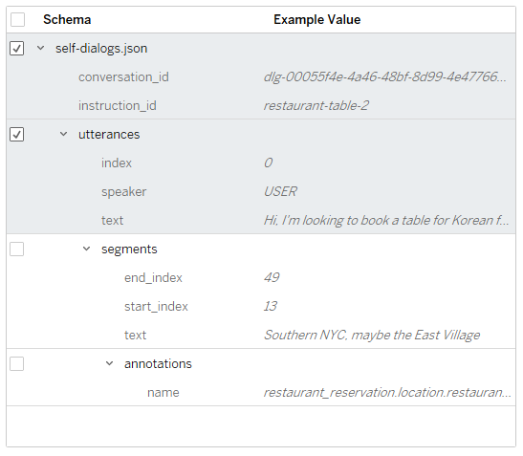
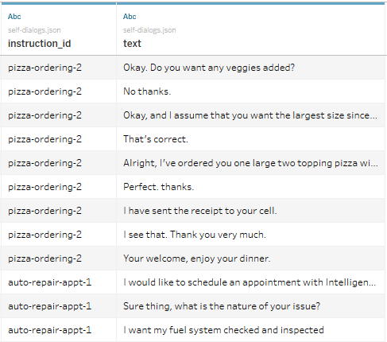
Introduction
Methodology
Results
Discussion
Conclusion
Data Preparation
Cleaning and NLP
Data Exploration
Feature Engineering & Selection
Model Evaluation & Selection
The data consists of dialog conversations in JSON format. We plan to import the JSON data and parse the conversation texts into a dataframe that has the concatenated dialog texts and labels.
Next we will perform Data Cleaning and NLP to obtain a normalized corpus that has white-space characters and stop words removed.

Slide 7
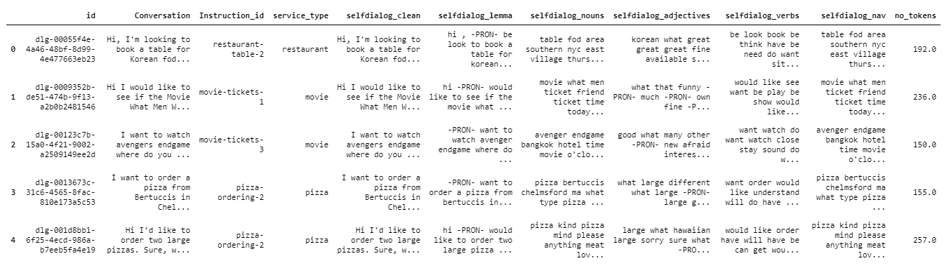
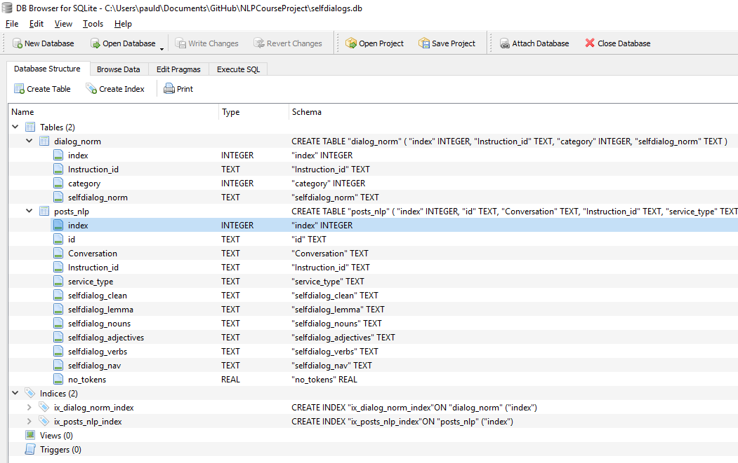
Introduction
Methodology
Results
Discussion
Conclusion
Data Preparation
Cleaning and NLP
Data Exploration
Feature Engineering & Selection
Model Evaluation & Selection

Slide 8
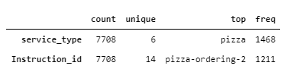
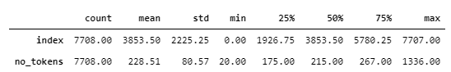
Introduction
Methodology
Results
Discussion
Conclusion
Data Preparation
Cleaning and NLP
Data Exploration
Statistical Analysis
Exploring Word Clouds
Exploring Complexity
Feature Engineering & Selection
Model Evaluation & Selection
Statistical Analysis

Slide 9
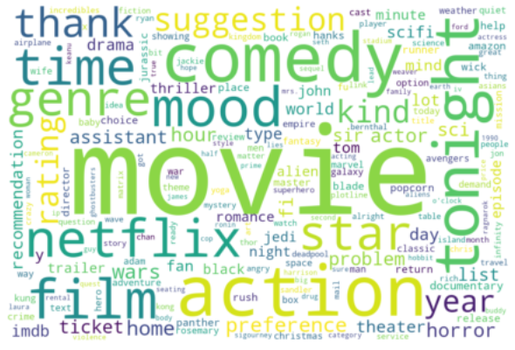
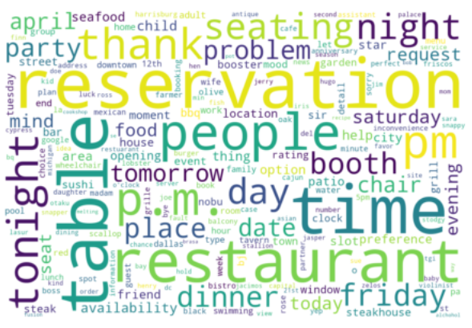
Introduction
Methodology
Results
Discussion
Conclusion
Data Preparation
Cleaning and NLP
Data Exploration
Statistical Analysis
Exploring Word Clouds
Exploring Complexity
Feature Engineering & Selection
Model Evaluation & Selection
movie-finder
Restaurant-table-3
Exploring Word Clouds
Created and displayed word clouds using the tokens created above and a second one
Notes:
TODO: Get a graph for the second word cloud

Slide 10
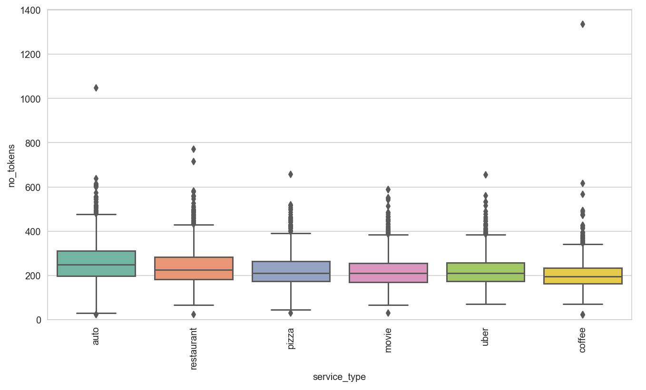
Introduction
Methodology
Results
Discussion
Conclusion
Data Preparation
Cleaning and NLP
Data Exploration
Statistical Analysis
Exploring Word Clouds
Exploring Complexity
Feature Engineering & Selection
Model Evaluation & Selection
Exploring Complexity
Reviewed for service type: average number of tokens; distribution of tokens; printed outliers; compared # of tokens per ‘instruction_id’

Slide 11
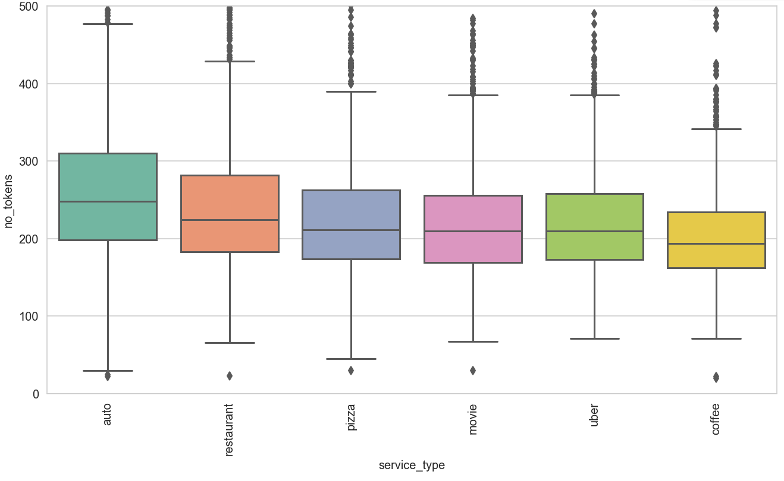
Introduction
Methodology
Results
Discussion
Conclusion
Data Preparation
Cleaning and NLP
Data Exploration
Statistical Analysis
Exploring Word Clouds
Exploring Complexity
Feature Engineering & Selection
Model Evaluation & Selection
Exploring Complexity
Reviewed for service type: average number of tokens; distribution of tokens; printed outliers; compared # of tokens per ‘instruction_id’

Slide 12
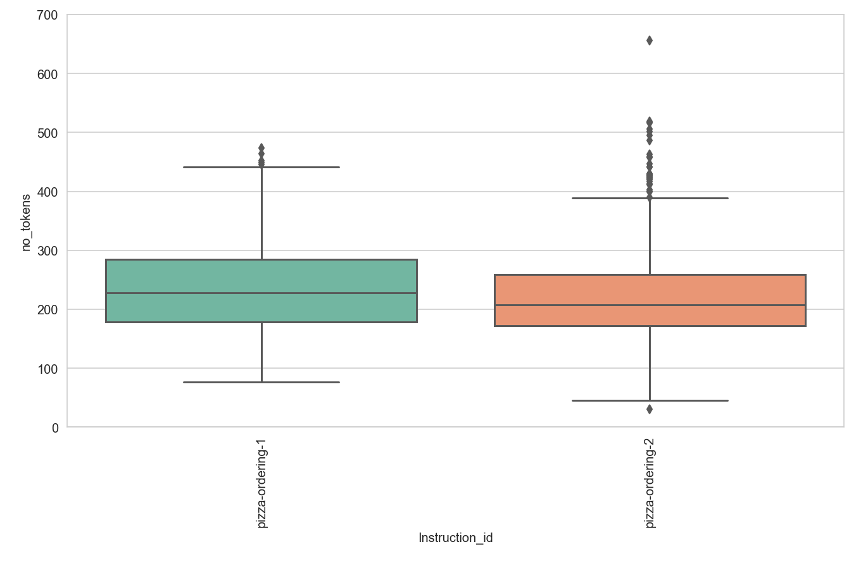
Introduction
Methodology
Results
Discussion
Conclusion
Data Preparation
Cleaning and NLP
Data Exploration
Statistical Analysis
Exploring Word Clouds
Exploring Complexity
Feature Engineering & Selection
Model Evaluation & Selection
Exploring Complexity
Reviewed for service type: average number of tokens; distribution of tokens; printed outliers; compared # of tokens per ‘instruction_id’

Slide 13
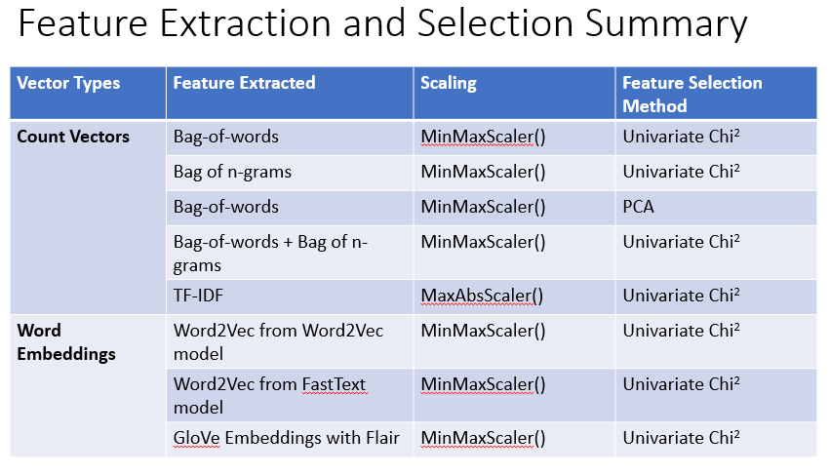
Introduction
Methodology
Results
Discussion
Conclusion
Data Preparation
Cleaning and NLP
Data Exploration
Feature Engineering & Selection
Balanced Dataset
Features Extracted:
Counting Methods
Bag of Words
Bag of N-Grams
PCA on Bag of Words
Combined Features: BOW + Bag of N-Grams
TF-IDF
Word Embeddings
Word2Vec
Word2Vec from FastText
Glove from FLAIR
Feature Selection Method:
Univariate – SelectKBest “Chi2’
PCA
Model Evaluation & Selection

Slide 14
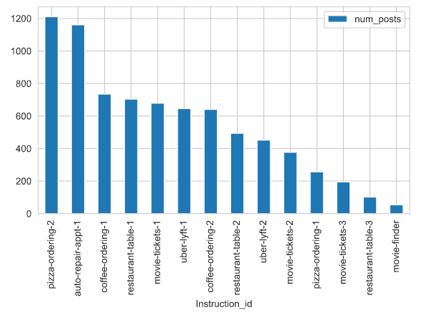
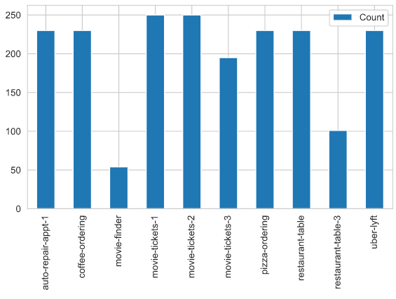
Introduction
Methodology
Results
Discussion
Conclusion
Data Preparation
Cleaning and NLP
Data Exploration
Feature Engineering & Selection
Balanced Dataset
Features Extracted:
Counting Methods
Bag of Words
Bag of N-Grams
PCA on Bag of Words
Combined Features: BOW + Bag of N-Grams
TF-IDF
Word Embeddings
Word2Vec
Word2Vec from FastText
Glove from FLAIR
Feature Selection Method:
Univariate – SelectKBest “Chi2’
PCA
Model Evaluation & Selection
Original Dataset: Unbalanced
Balanced Dataset
Data Balancing:
The original dataset was not balanced, the steps to balance were:
Merging of similar classes
Manual setting of number of samples

Slide 15
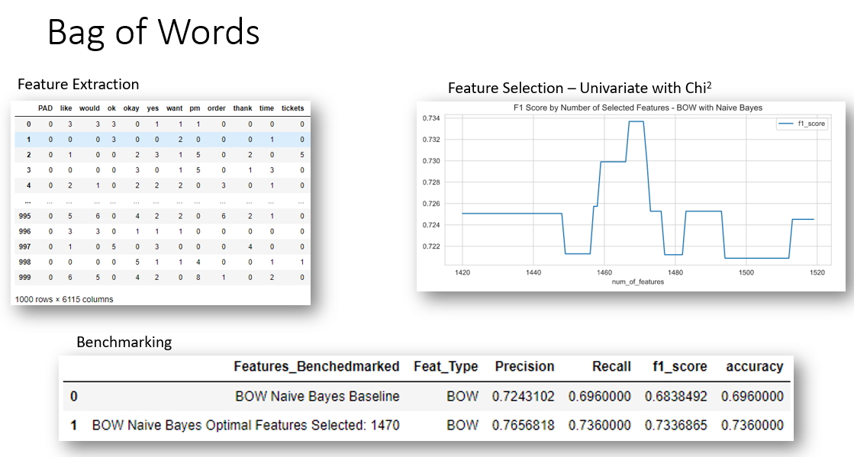
Introduction
Methodology
Results
Discussion
Conclusion
Data Preparation
Cleaning and NLP
Data Exploration
Feature Engineering & Selection
Balanced Dataset
Features Extracted:
Counting Methods
Bag of Words
Bag of N-Grams
PCA on Bag of Words
Combined Features: BOW + Bag of N-Grams
TF-IDF
Word Embeddings
Word2Vec
Word2Vec from FastText
Glove from FLAIR
Feature Selection Method:
Univariate – SelectKBest “Chi2’
PCA
Model Evaluation & Selection
Notes:
TODO: Add some screen shots or diagrams of the different feature extractions

Slide 16
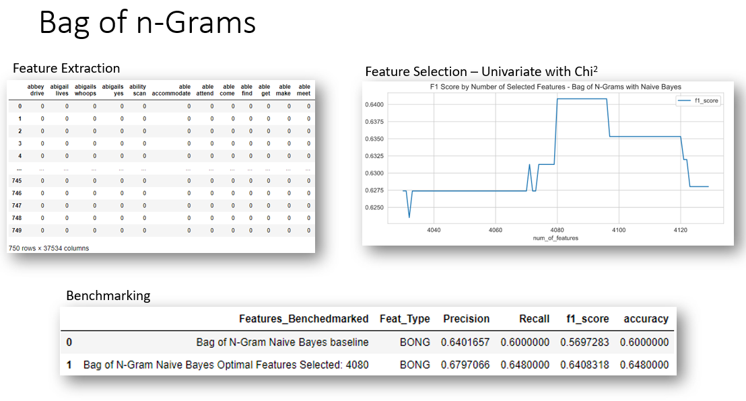
Introduction
Methodology
Results
Discussion
Conclusion
Data Preparation
Cleaning and NLP
Data Exploration
Feature Engineering & Selection
Balanced Dataset
Features Extracted:
Counting Methods
Bag of Words
Bag of N-Grams
PCA on Bag of Words
Combined Features: BOW + Bag of N-Grams
TF-IDF
Word Embeddings
Word2Vec
Word2Vec from FastText
Glove from FLAIR
Feature Selection Method:
Univariate – SelectKBest “Chi2’
PCA
Model Evaluation & Selection
Notes:
TODO: Add some screen shots or diagrams of the different feature extractions

Slide 17
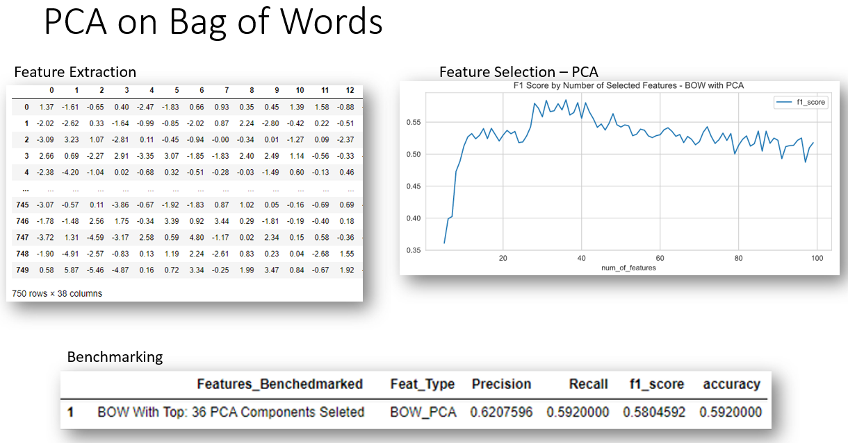
Introduction
Methodology
Results
Discussion
Conclusion
Data Preparation
Cleaning and NLP
Data Exploration
Feature Engineering & Selection
Balanced Dataset
Features Extracted:
Counting Methods
Bag of Words
Bag of N-Grams
PCA on Bag of Words
Combined Features: BOW + Bag of N-Grams
TF-IDF
Word Embeddings
Word2Vec
Word2Vec from FastText
Glove from FLAIR
Feature Selection Method:
Univariate – SelectKBest “Chi2’
PCA
Model Evaluation & Selection
Notes:
TODO: Add some screen shots or diagrams of the different feature extractions

Slide 18
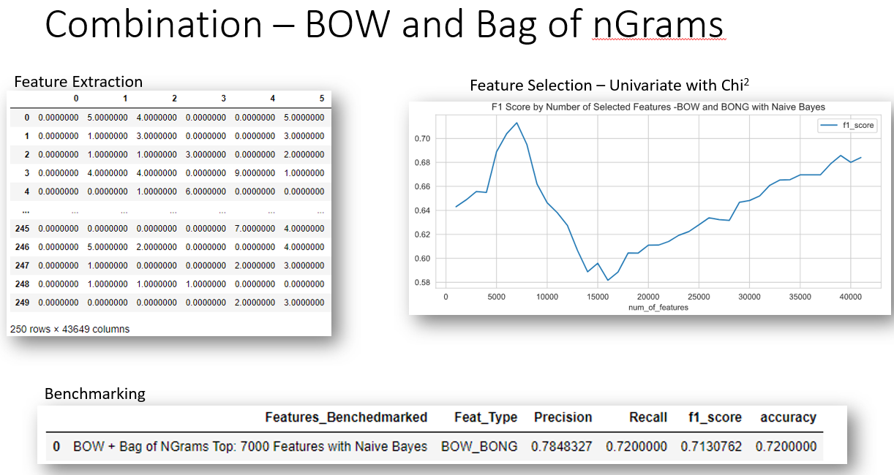
Introduction
Methodology
Results
Discussion
Conclusion
Data Preparation
Cleaning and NLP
Data Exploration
Feature Engineering & Selection
Balanced Dataset
Features Extracted:
Counting Methods
Bag of Words
Bag of N-Grams
PCA on Bag of Words
Combined Features: BOW + Bag of N-Grams
TF-IDF
Word Embeddings
Word2Vec
Word2Vec from FastText
Glove from FLAIR
Feature Selection Method:
Univariate – SelectKBest “Chi2’
PCA
Model Evaluation & Selection
Notes:
TODO: Add some screen shots or diagrams of the different feature extractions

Slide 19
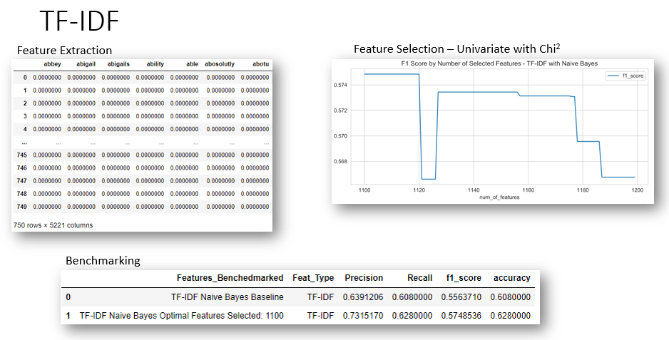
Introduction
Methodology
Results
Discussion
Conclusion
Data Preparation
Cleaning and NLP
Data Exploration
Feature Engineering & Selection
Balanced Dataset
Features Extracted:
Counting Methods
Bag of Words
Bag of N-Grams
PCA on Bag of Words
Combined Features: BOW + Bag of N-Grams
TF-IDF
Word Embeddings
Word2Vec
Word2Vec from FastText
Glove from FLAIR
Feature Selection Method:
Univariate – SelectKBest “Chi2’
PCA
Model Evaluation & Selection
Notes:
TODO: Add some screen shots or diagrams of the different feature extractions

Slide 20
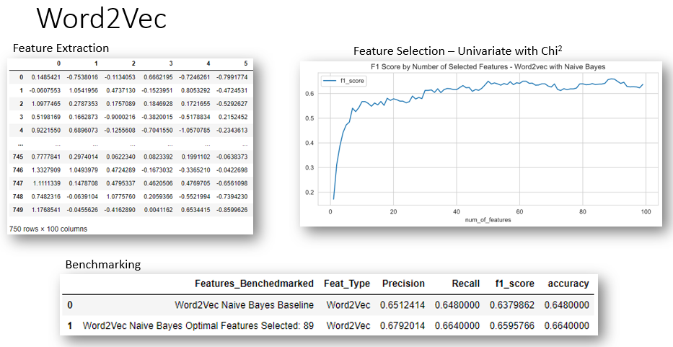
Introduction
Methodology
Results
Discussion
Conclusion
Data Preparation
Cleaning and NLP
Data Exploration
Feature Engineering & Selection
Balanced Dataset
Features Extracted:
Counting Methods
Bag of Words
Bag of N-Grams
PCA on Bag of Words
Combined Features: BOW + Bag of N-Grams
TF-IDF
Word Embeddings
Word2Vec
Word2Vec from FastText
Glove from FLAIR
Feature Selection Method:
Univariate – SelectKBest “Chi2’
PCA
Model Evaluation & Selection

Slide 21
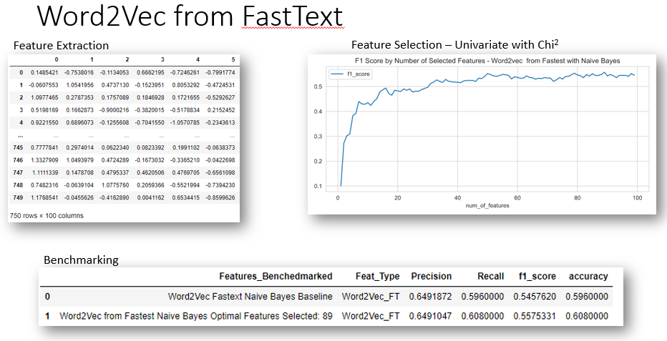
Introduction
Methodology
Results
Discussion
Conclusion
Data Preparation
Cleaning and NLP
Data Exploration
Feature Engineering & Selection
Balanced Dataset
Features Extracted:
Counting Methods
Bag of Words
Bag of N-Grams
PCA on Bag of Words
Combined Features: BOW + Bag of N-Grams
TF-IDF
Word Embeddings
Word2Vec
Word2Vec from FastText
Glove from FLAIR
Feature Selection Method:
Univariate – SelectKBest “Chi2’
PCA
Model Evaluation & Selection

Slide 22
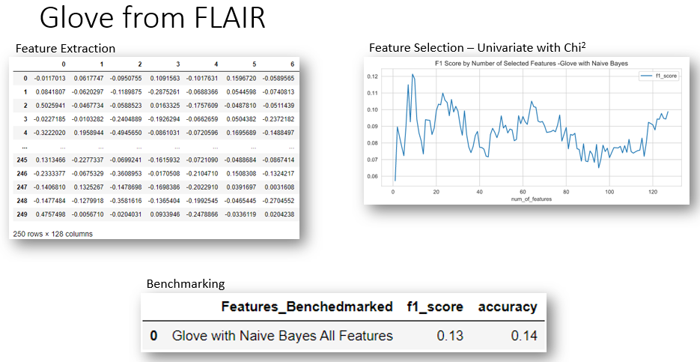
Introduction
Methodology
Results
Discussion
Conclusion
Data Preparation
Cleaning and NLP
Data Exploration
Feature Engineering & Selection
Balanced Dataset
Features Extracted:
Counting Methods
Bag of Words
Bag of N-Grams
PCA on Bag of Words
Combined Features: BOW + Bag of N-Grams
TF-IDF
Word Embeddings
Word2Vec
Word2Vec from FastText
Glove from FLAIR
Feature Selection Method:
Univariate – SelectKBest “Chi2’
PCA
Model Evaluation & Selection

Slide 23
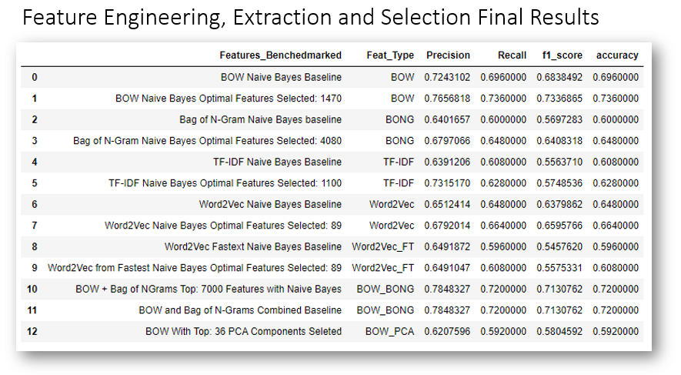
Introduction
Methodology
Results
Discussion
Conclusion
Data Preparation
Cleaning and NLP
Data Exploration
Feature Engineering & Selection
Balanced Dataset
Features Extracted:
Counting Methods
Bag of Words
Bag of N-Grams
PCA on Bag of Words
Combined Features: BOW + Bag of N-Grams
TF-IDF
Word Embeddings
Word2Vec
Word2Vec from FastText
Glove from FLAIR
Feature Selection Method:
Univariate – SelectKBest “Chi2’
PCA
Model Evaluation & Selection

Slide 24
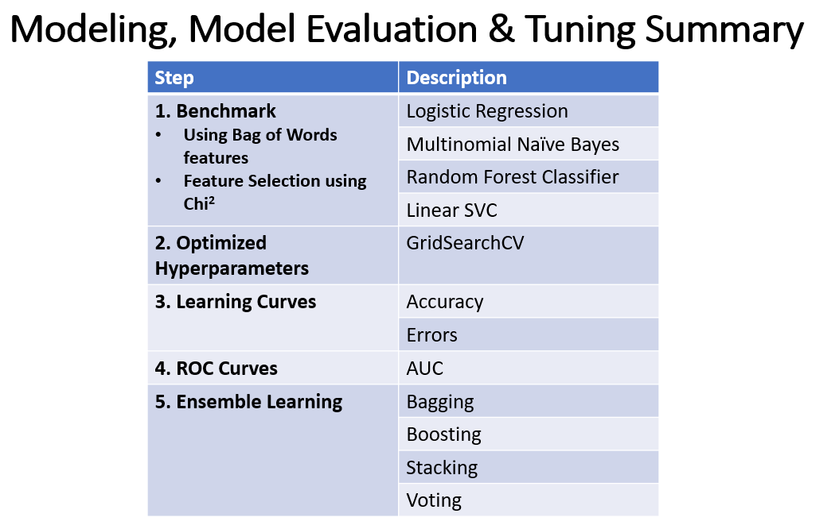
Introduction
Methodology
Results
Discussion
Conclusion
Data Preparation
Cleaning and NLP
Data Exploration
Feature Engineering & Selection
Model Evaluation & Selection
Features Selected
Bag of Words
Univariate SelectKBest - chi2
Models Benchmark
Logistic Regression
Multinomial Naïve Bayes
Random Forest Classifier
Linear SVC
Optimized Parameters
GridSearchCV
Ensemble Learning
Bagging
Boosting
Stacking
Voting

Slide 25
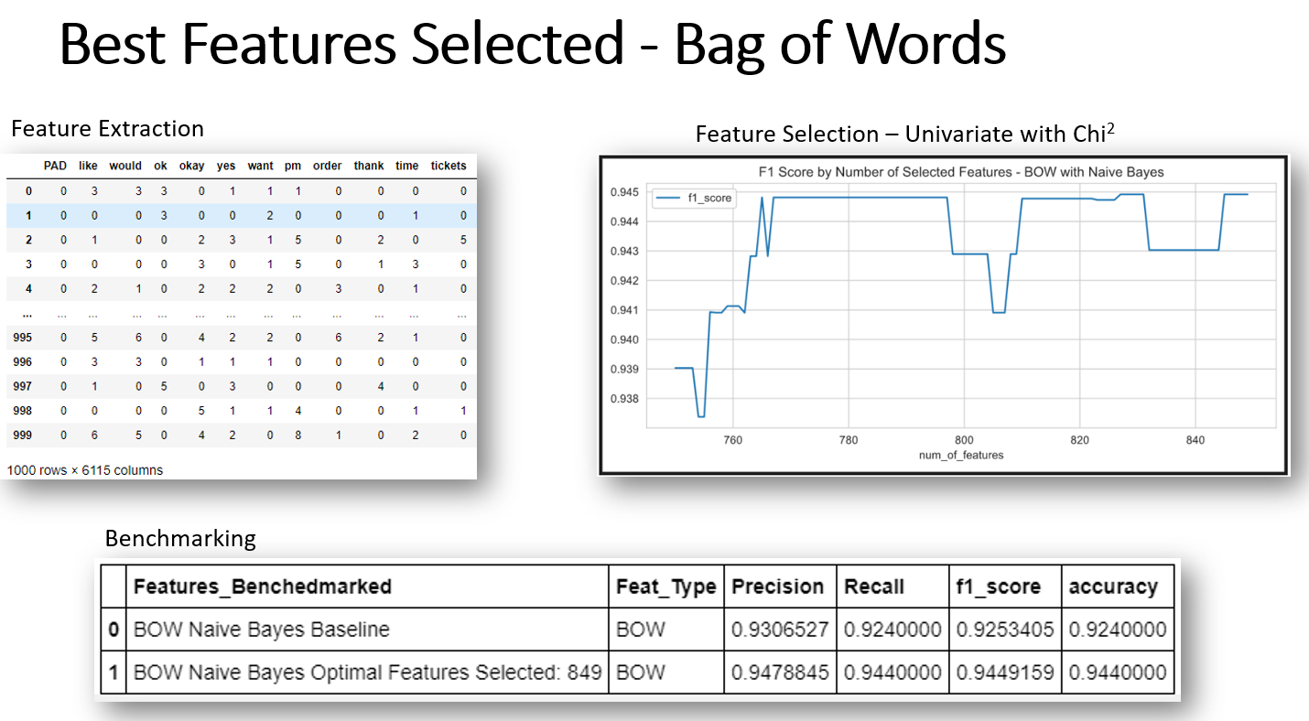
Introduction
Methodology
Results
Discussion
Conclusion
Data Preparation
Cleaning and NLP
Data Exploration
Feature Engineering & Selection
Model Evaluation & Selection
Features Selected
Bag of Words
Univariate SelectKBest - chi2
Models Benchmark
Logistic Regression
Multinomial Naïve Bayes
Random Forest Classifier
Linear SVC
Optimized Parameters
GridSearchCV
Ensemble Learning
Bagging
Boosting
Stacking
Voting

Slide 26
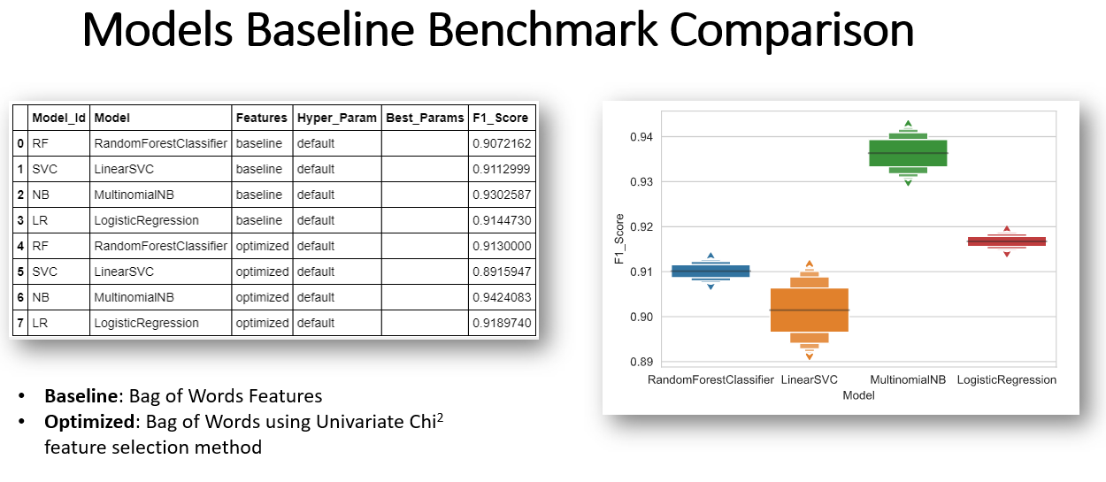
Introduction
Methodology
Results
Discussion
Conclusion
Data Preparation
Cleaning and NLP
Data Exploration
Feature Engineering & Selection
Model Evaluation & Selection
Features Selected
Bag of Words
Univariate SelectKBest - chi2
Models Benchmark
Logistic Regression
Multinomial Naïve Bayes
Random Forest Classifier
Linear SVC
Optimized Parameters
GridSearchCV
Ensemble Learning
Bagging
Boosting
Stacking
Voting

Slide 27
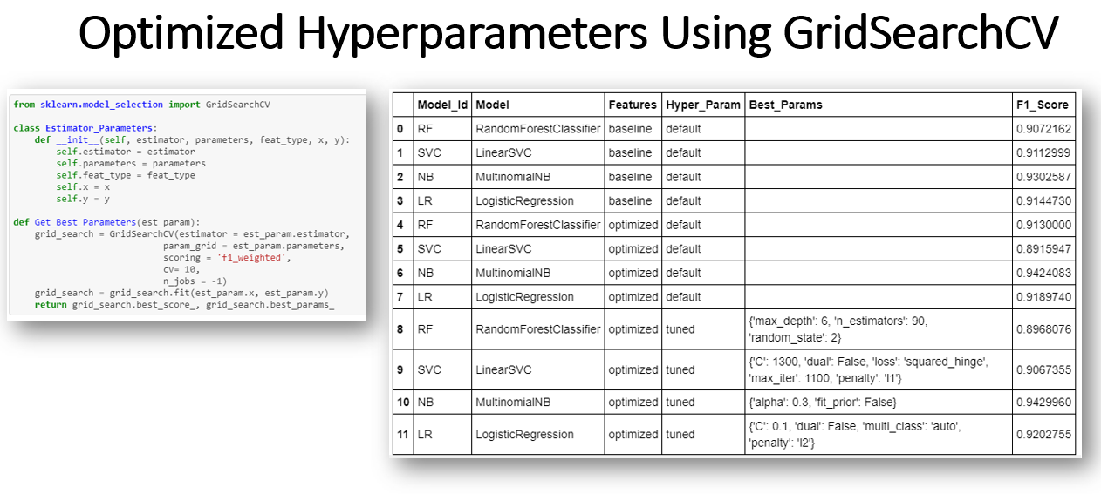
Introduction
Methodology
Results
Discussion
Conclusion
Data Preparation
Cleaning and NLP
Data Exploration
Feature Engineering & Selection
Model Evaluation & Selection
Features Selected
Bag of Words
Univariate SelectKBest - chi2
Models Benchmark
Logistic Regression
Multinomial Naïve Bayes
Random Forest Classifier
Linear SVC
Optimized Parameters
GridSearchCV
Ensemble Learning
Bagging
Boosting
Stacking
Voting

Slide 28
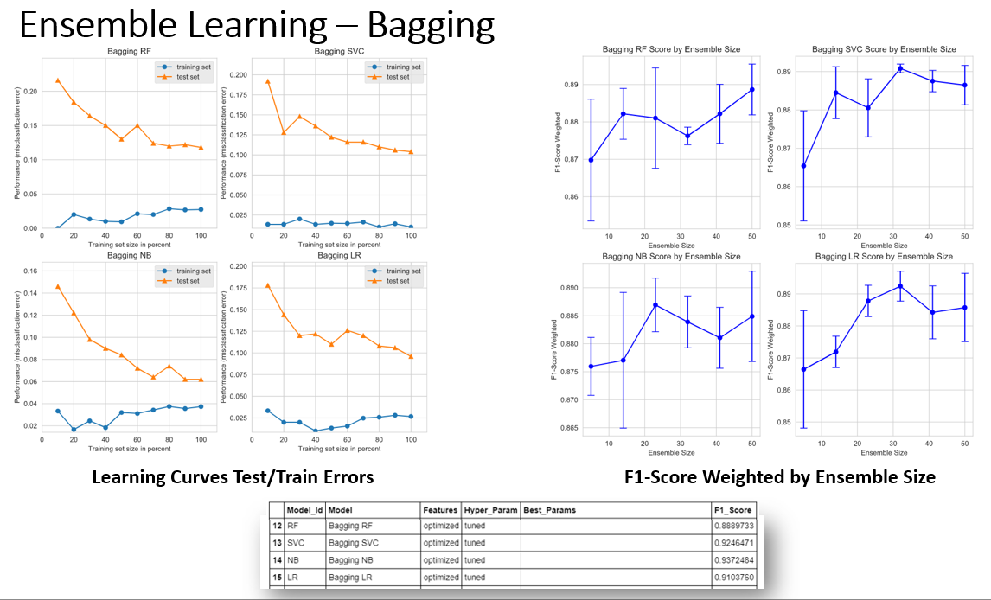
Introduction
Methodology
Results
Discussion
Conclusion
Data Preparation
Cleaning and NLP
Data Exploration
Feature Engineering & Selection
Model Evaluation & Selection
Features Selected
Bag of Words
Univariate SelectKBest - chi2
Models Benchmark
Logistic Regression
Multinomial Naïve Bayes
Random Forest Classifier
Linear SVC
Optimized Parameters
GridSearchCV
Ensemble Learning
Bagging
Boosting
Stacking
Voting

Slide 29
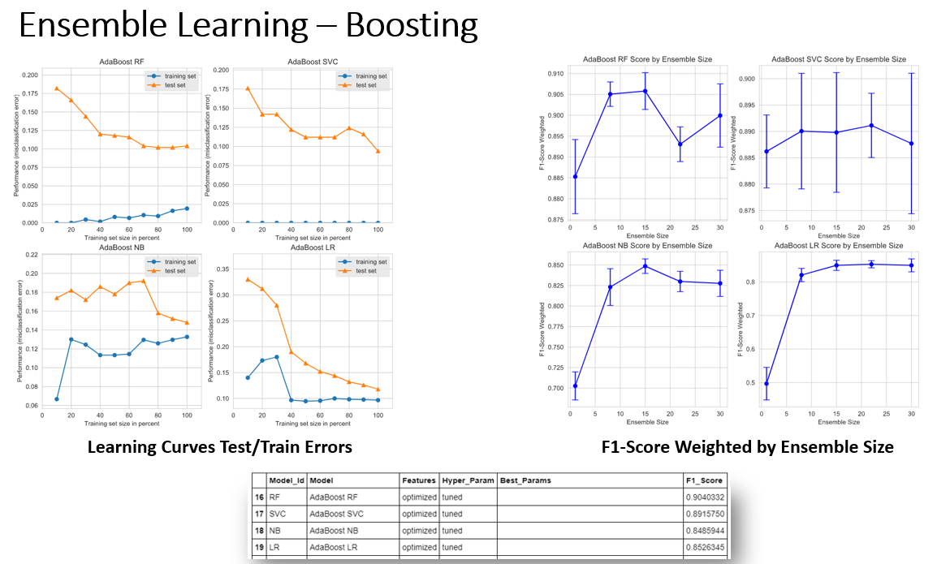
Introduction
Methodology
Results
Discussion
Conclusion
Data Preparation
Cleaning and NLP
Data Exploration
Feature Engineering & Selection
Model Evaluation & Selection
Features Selected
Bag of Words
Univariate SelectKBest - chi2
Models Benchmark
Logistic Regression
Multinomial Naïve Bayes
Random Forest Classifier
Linear SVC
Optimized Parameters
GridSearchCV
Ensemble Learning
Bagging
Boosting
Stacking
Voting

Slide 30
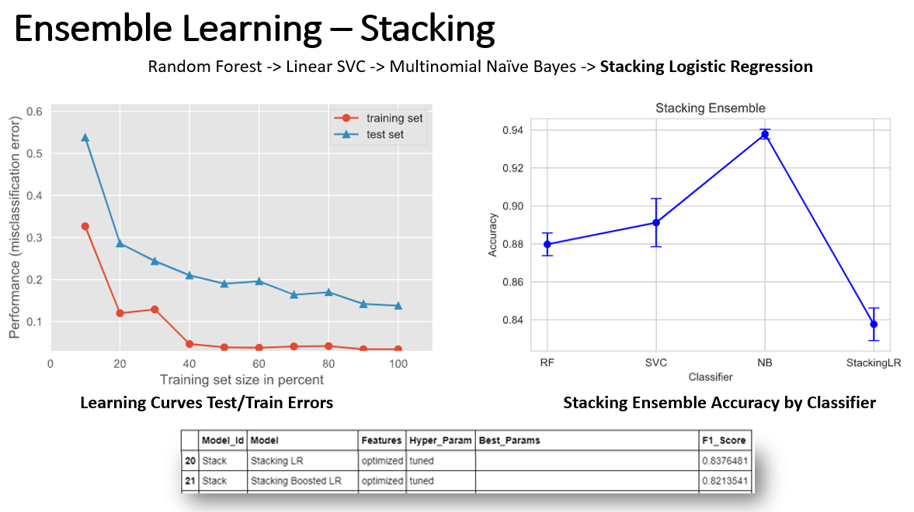
Introduction
Methodology
Results
Discussion
Conclusion
Data Preparation
Cleaning and NLP
Data Exploration
Feature Engineering & Selection
Model Evaluation & Selection
Features Selected
Bag of Words
Univariate SelectKBest - chi2
Models Benchmark
Logistic Regression
Multinomial Naïve Bayes
Random Forest Classifier
Linear SVC
Optimized Parameters
GridSearchCV
Ensemble Learning
Bagging
Boosting
Stacking
Voting

Slide 31
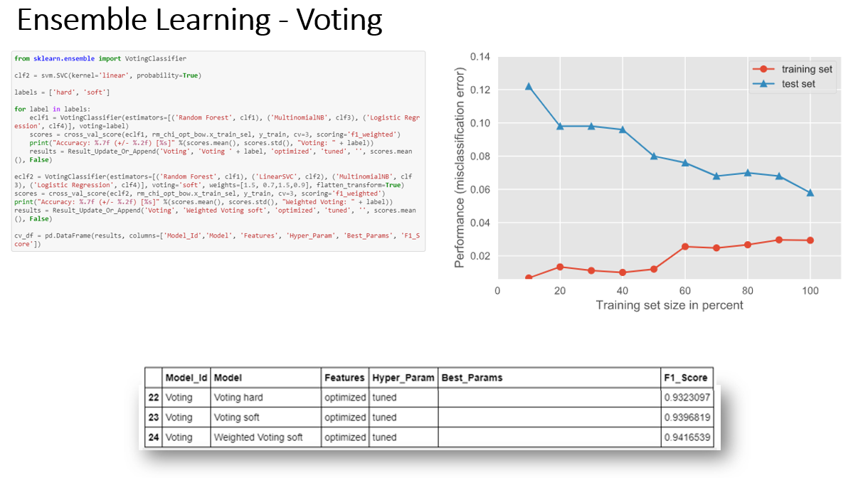
Introduction
Methodology
Results
Discussion
Conclusion
Data Preparation
Cleaning and NLP
Data Exploration
Feature Engineering & Selection
Model Evaluation & Selection
Features Selected
Bag of Words
Univariate SelectKBest - chi2
Models Benchmark
Logistic Regression
Multinomial Naïve Bayes
Random Forest Classifier
Linear SVC
Optimized Parameters
GridSearchCV
Ensemble Learning
Bagging
Boosting
Stacking
Voting

Slide 32
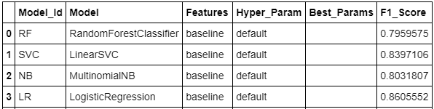
Introduction
Methodology
Results
Discussion
Conclusion
Baseline Models Benchmarks
Feature Optimized Models Benchmarks
Hyperparameter Tuned Benchmarks
Learning Curves
ROC Curves / AUC
Bagging Ensemble Learning Benchmarks
Training / Testing Errors
F1-Score by Ensemble Size
Boosting Ensemble Learning Benchmarks
Training / Testing Errors
F1-Score by Ensemble Size
Stacking Ensemble Learning Benchmarks
Training / Testing Errors
F1-Score by Classifier
Voting Ensemble Learning Benchmarks
Training / Testing Errors
Overall Benchmarks
Baseline Models Benchmarks

Slide 33
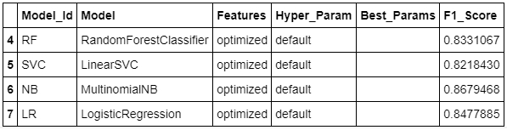
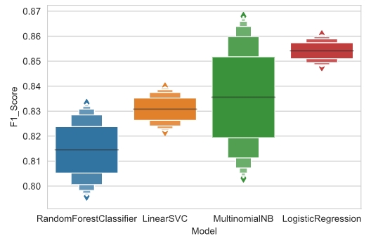
Introduction
Methodology
Results
Discussion
Conclusion
Baseline Models Benchmarks
Feature Optimized Models Benchmarks
Hyperparameter Tuned Benchmarks
Learning Curves
ROC Curves / AUC
Bagging Ensemble Learning Benchmarks
Training / Testing Errors
F1-Score by Ensemble Size
Boosting Ensemble Learning Benchmarks
Training / Testing Errors
F1-Score by Ensemble Size
Stacking Ensemble Learning Benchmarks
Training / Testing Errors
F1-Score by Classifier
Voting Ensemble Learning Benchmarks
Training / Testing Errors
Overall Benchmarks
Feature Optimized Models Benchmarks
Comparison of Baseline and Feature Optimized Models Benchmarks.

Slide 34
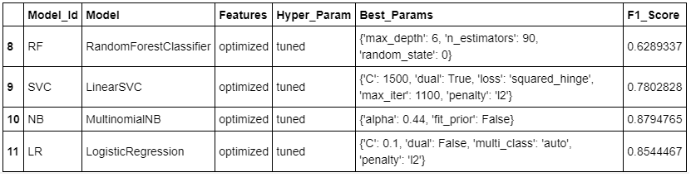
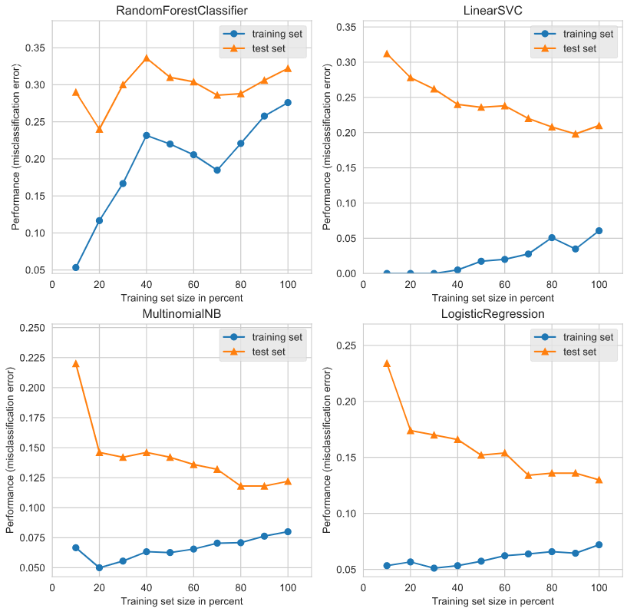
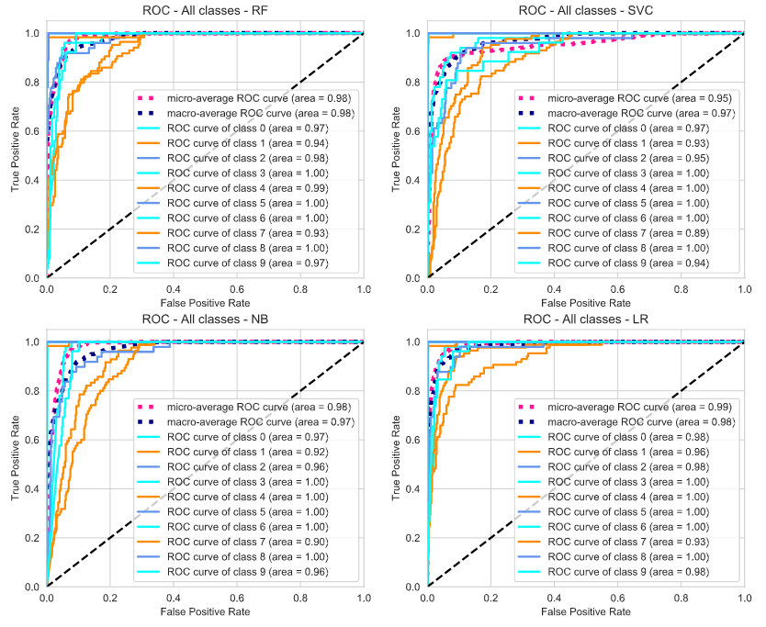
Introduction
Methodology
Results
Discussion
Conclusion
Baseline Models Benchmarks
Feature Optimized Models Benchmarks
Hyperparameter Tuned Benchmarks
Learning Curves
ROC Curves / AUC
Bagging Ensemble Learning Benchmarks
Training / Testing Errors
F1-Score by Ensemble Size
Boosting Ensemble Learning Benchmarks
Training / Testing Errors
F1-Score by Ensemble Size
Stacking Ensemble Learning Benchmarks
Training / Testing Errors
F1-Score by Classifier
Voting Ensemble Learning Benchmarks
Training / Testing Errors
Overall Benchmarks
Hyperparameters Tuned Benchmarks
Training / Testing Errors
ROC Curves / AUC

Slide 35
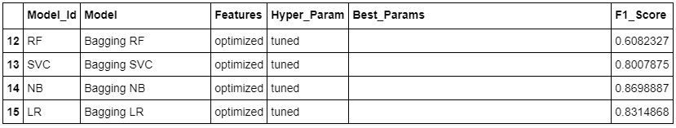
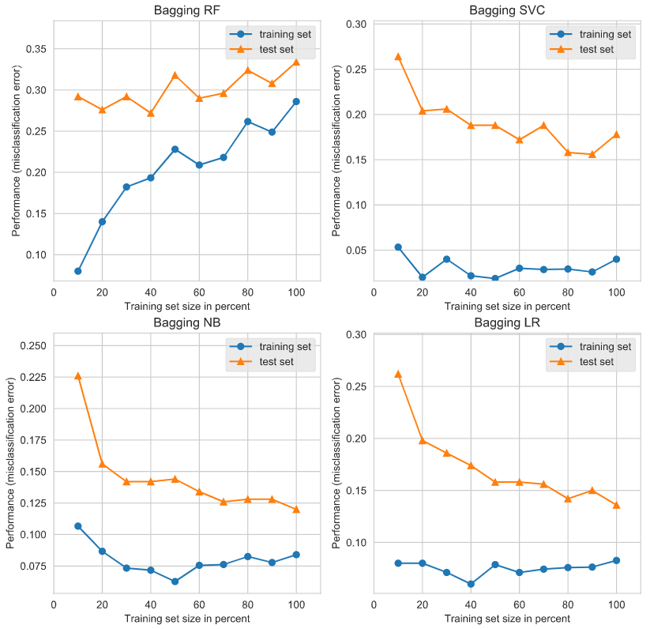
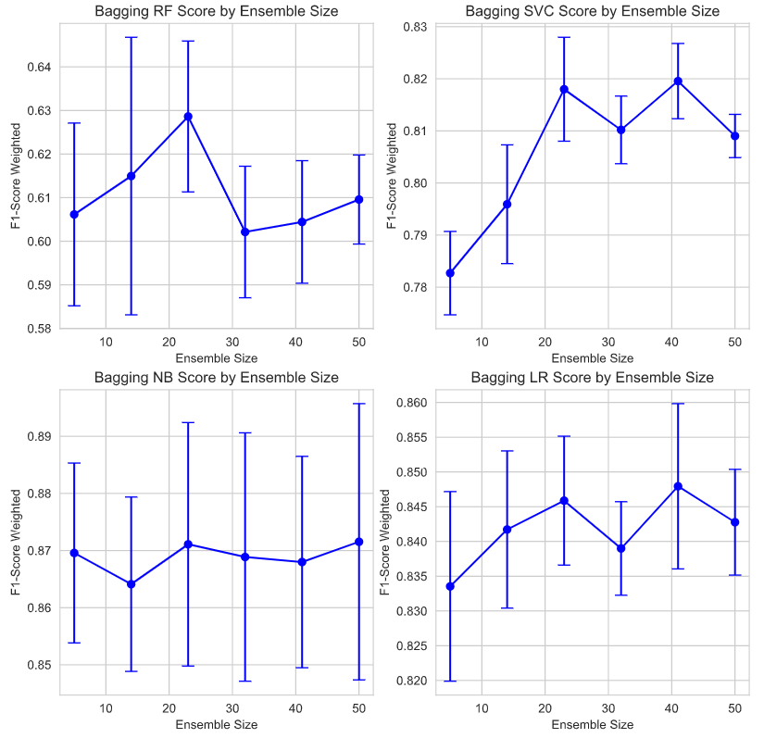
Introduction
Methodology
Results
Discussion
Conclusion
Baseline Models Benchmarks
Feature Optimized Models Benchmarks
Hyperparameter Tuned Benchmarks
Learning Curves
ROC Curves / AUC
Bagging Ensemble Learning Benchmarks
Training / Testing Errors
F1-Score by Ensemble Size
Boosting Ensemble Learning Benchmarks
Training / Testing Errors
F1-Score by Ensemble Size
Stacking Ensemble Learning Benchmarks
Training / Testing Errors
F1-Score by Classifier
Voting Ensemble Learning Benchmarks
Training / Testing Errors
Overall Benchmarks
Bagging Ensemble Learning Benchmarks
Training / Testing Errors
F1-Score By Ensemble Size

Slide 36
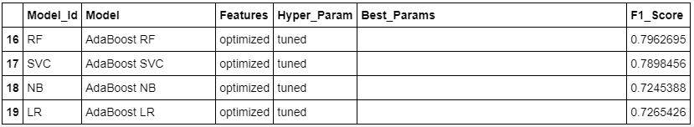
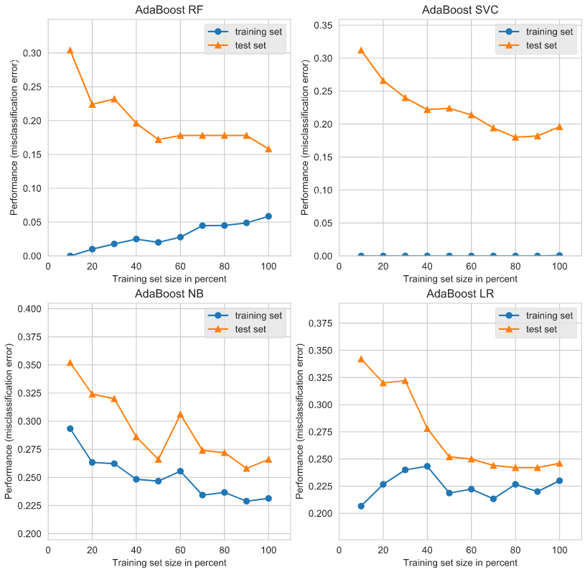
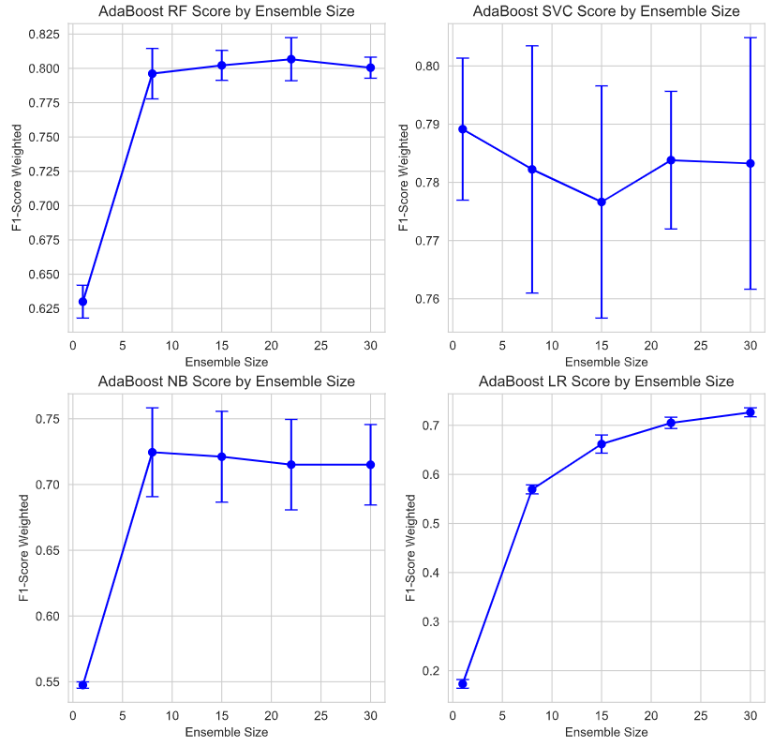
Introduction
Methodology
Results
Discussion
Conclusion
Baseline Models Benchmarks
Feature Optimized Models Benchmarks
Hyperparameter Tuned Benchmarks
Learning Curves
ROC Curves / AUC
Bagging Ensemble Learning Benchmarks
Training / Testing Errors
F1-Score by Ensemble Size
Boosting Ensemble Learning Benchmarks
Training / Testing Errors
F1-Score by Ensemble Size
Stacking Ensemble Learning Benchmarks
Training / Testing Errors
F1-Score by Classifier
Voting Ensemble Learning Benchmarks
Training / Testing Errors
Overall Benchmarks
Boosting Ensemble Learning Benchmarks
Training / Testing Errors
F1-Score By Ensemble Size

Slide 37
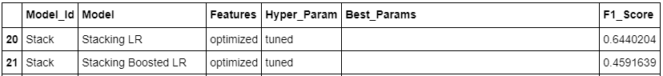
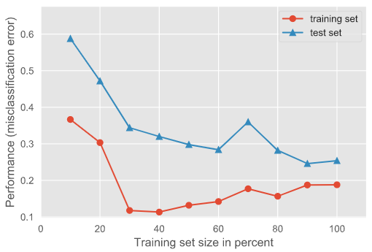
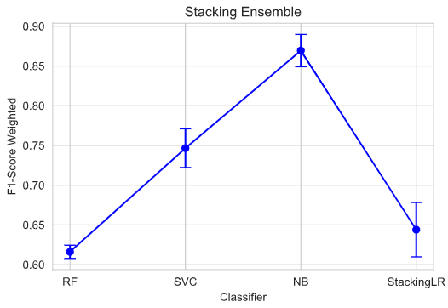
Introduction
Methodology
Results
Discussion
Conclusion
Baseline Models Benchmarks
Feature Optimized Models Benchmarks
Hyperparameter Tuned Benchmarks
Learning Curves
ROC Curves / AUC
Bagging Ensemble Learning Benchmarks
Learning Curves
F1-Score by Ensemble Size
Boosting Ensemble Learning Benchmarks
Learning Curves
F1-Score by Ensemble Size
Stacking Ensemble Learning Benchmarks
Training / Testing Errors
F1-Score by Classifier
Voting Ensemble Learning Benchmarks
Training / Testing Errors
Overall Benchmarks
Stacking Ensemble Learning Benchmarks
Random Forest -> Linear SVC -> Multinomial Naïve Bayes -> Stacking Logistic Regression
Training / Testing Errors
F1-Score By Classifier

Slide 38
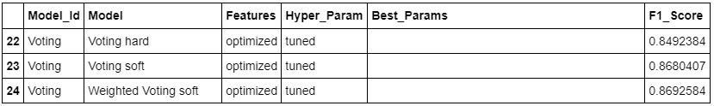
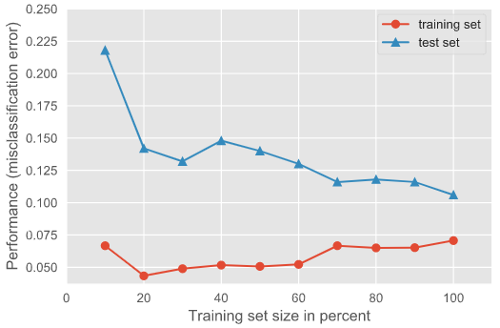
Introduction
Methodology
Results
Discussion
Conclusion
Baseline Models Benchmarks
Feature Optimized Models Benchmarks
Hyperparameter Tuned Benchmarks
Learning Curves
ROC Curves / AUC
Bagging Ensemble Learning Benchmarks
Learning Curves
F1-Score by Ensemble Size
Boosting Ensemble Learning Benchmarks
Learning Curves
F1-Score by Ensemble Size
Stacking Ensemble Learning Benchmarks
Learning Curves
F1-Score by Ensemble Size
Voting Ensemble Learning Benchmarks
Training / Testing Errors
Overall Benchmarks
Voting Ensemble Learning Benchmarks
Training / Testing Errors
Voting Classifier supports two types of voting:
hard: the final class prediction is made by a majority vote — the estimator chooses the class prediction that occurs most frequently among the base models
soft: the final class prediction is made based on the average probability calculated using all the base model predictions.

Slide 39
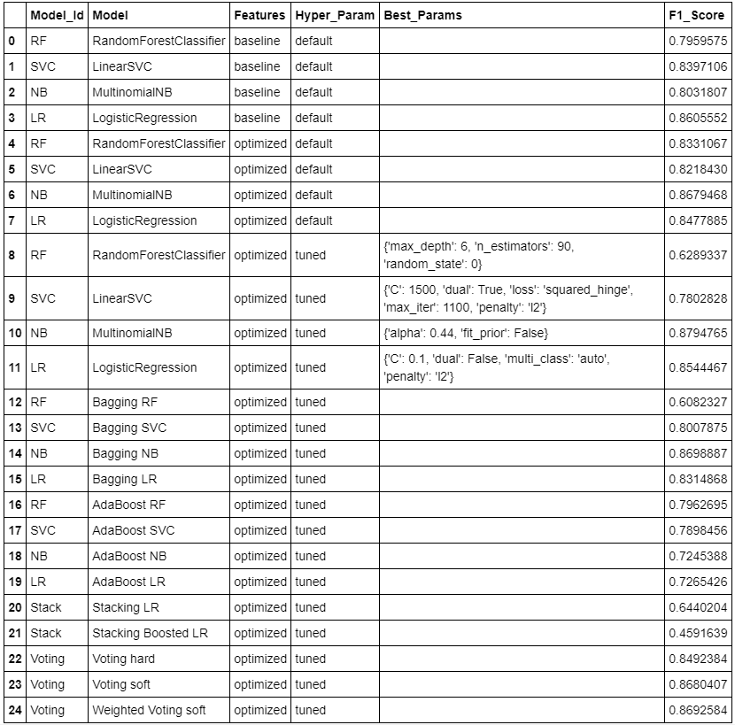
Introduction
Methodology
Results
Discussion
Conclusion
Baseline Models Benchmarks
Feature Optimized Models Benchmarks
Hyperparameter Tuned Benchmarks
Learning Curves
ROC Curves / AUC
Bagging Ensemble Learning Benchmarks
Learning Curves
F1-Score by Ensemble Size
Boosting Ensemble Learning Benchmarks
Learning Curves
F1-Score by Ensemble Size
Stacking Ensemble Learning Benchmarks
Learning Curves
F1-Score by Ensemble Size
Voting Ensemble Learning Benchmarks
Training / Testing Errors
Overall Benchmarks

Slide 40
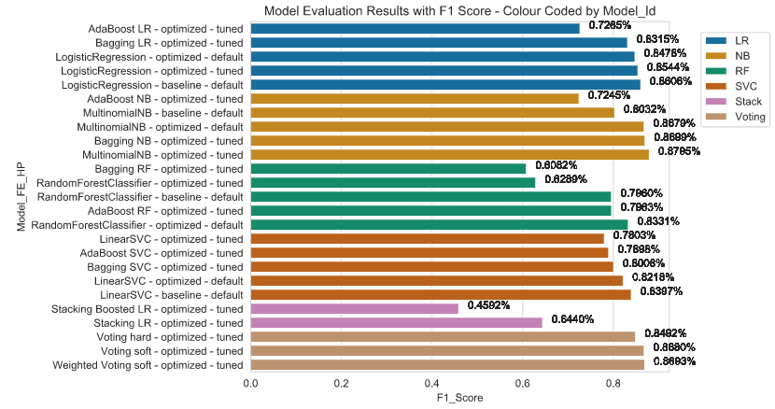
Introduction
Methodology
Results
Discussion
Conclusion
Baseline Models Benchmarks
Feature Optimized Models Benchmarks
Hyperparameter Tuned Benchmarks
Learning Curves
ROC Curves / AUC
Bagging Ensemble Learning Benchmarks
Learning Curves
F1-Score by Ensemble Size
Boosting Ensemble Learning Benchmarks
Learning Curves
F1-Score by Ensemble Size
Stacking Ensemble Learning Benchmarks
Learning Curves
F1-Score by Ensemble Size
Voting Ensemble Learning Benchmarks
Training / Testing Errors
Overall Benchmarks

Slide 41

Introduction
Methodology
Results
Discussion
Conclusion
Baseline Models Benchmarks
Feature Optimized Models Benchmarks
Hyperparameter Tuned Benchmarks
Learning Curves
ROC Curves / AUC
Bagging Ensemble Learning Benchmarks
Learning Curves
F1-Score by Ensemble Size
Boosting Ensemble Learning Benchmarks
Learning Curves
F1-Score by Ensemble Size
Stacking Ensemble Learning Benchmarks
Learning Curves
F1-Score by Ensemble Size
Voting Ensemble Learning Benchmarks
Training / Testing Errors
Overall Benchmarks

Slide 42


Introduction
Methodology
Results
Discussion
Conclusion
Comparison and Analysis
Confusion Matrix from M1 and M2
Comparison of the progression: from baseline thru ensemble
Comparison of 2000 & 4000 records: Learning Curves and F1-Score (covers the bias-variance tradeoff)
Interpreting and Explaining Models
Feature Importance
Individual Tree Visualization
ELI5
LIME
Skater
At End of Feature Selection
At the End of the Model Selection
Comparison of the confusion matrices at the end of feature selection and end of model evaluation and selection gives a visual of how the results improved.

Slide 43
Introduction
Methodology
Results
Discussion
Conclusion
Comparison and Analysis
Confusion Matrix from M1 and M2
Comparison of the progression: from baseline thru ensemble
Comparison of 2000 & 4000 records: Learning Curves and F1-Score (covers the bias-variance tradeoff)
Interpreting and Explaining Models
Feature Importance
Individual Tree Visualization
ELI5
LIME
Skater
Comparison of the Progression from baseline thru ensemble learning

Slide 44
Introduction
Methodology
Results
Discussion
Conclusion
Comparison and Analysis
Confusion Matrix from M1 and M2
Comparison of the progression: from baseline thru ensemble
Comparison of 2000 & 4000 records: Learning Curves and F1-Score (covers the bias-variance tradeoff)
Interpreting and Explaining Models
Feature Importance
Individual Tree Visualization
ELI5
LIME
Skater
Comparison of the Progression from baseline thru ensemble learning

Slide 45
Introduction
Methodology
Results
Discussion
Conclusion
Comparison and Analysis
Confusion Matrix from M1 and M2
Comparison of the progression: from baseline thru ensemble
Comparison of 2000 & 4000 records: Learning Curves and F1-Score (covers the bias-variance tradeoff)
Interpreting and Explaining Models
Feature Importance
Individual Tree Visualization
ELI5
LIME
Skater
Comparison of the Progression from baseline thru ensemble learning
The RF, SVC, NB and LR violins are showing the variance from the baseline thru the ensemble learning for the different model types. The general trend is an improvement up to the tuning of the hyperparameters.
Generally, the ensemble learning methods did not score better than the models with optimized features and hyperparameters tuned. However the voting ensemble almost matched the best tuned models.

Slide 46


Introduction
Methodology
Results
Discussion
Conclusion
Comparison and Analysis
Confusion Matrix from M1 and M2
Comparison of the progression: from baseline thru ensemble
Comparison of 2000 & 4000 records: Learning Curves and F1-Score (covers the bias-variance tradeoff)
Interpreting and Explaining Models
Feature Importance
Individual Tree Visualization
ELI5
LIME
Skater
Training /Testing Errors 2000 Samples
Training /Testing Errors 4000 Samples
Increasing the number of samples reduces the overall error, which reduces bias.
The variance gap reduced for all model types
The error and bias is reduced for all model types

Slide 47

Introduction
Methodology
Results
Discussion
Conclusion
Comparison and Analysis
Confusion Matrix from M1 and M2
Comparison of the progression: from baseline thru ensemble
Comparison of 2000 & 4000 records: Learning Curves and F1-Score (covers the bias-variance tradeoff)
Interpreting and Explaining Models
Feature Importance
Individual Tree Visualization
ELI5
LIME
Skater
Feature Importance: lists the importance factor of specific words in the corpus in determining the classification
Words identified show correlation with the classes

Slide 48

Introduction
Methodology
Results
Discussion
Conclusion
Comparison and Analysis
Confusion Matrix from M1 and M2
Comparison of the progression: from baseline thru ensemble
Comparison of 2000 & 4000 records: Learning Curves and F1-Score (covers the bias-variance tradeoff)
Interpreting and Explaining Models
Feature Importance
Individual Tree Visualization
ELI5
LIME
Skater
Individual Tree Visualization: gives insight into the decision path for making a specific prediction

Slide 49


Introduction
Methodology
Results
Discussion
Conclusion
Comparison and Analysis
Confusion Matrix from M1 and M2
Comparison of the progression: from baseline thru ensemble
Comparison of 2000 & 4000 records: Learning Curves and F1-Score (covers the bias-variance tradeoff)
Interpreting and Explaining Models
Feature Importance
Individual Tree Visualization
ELI5
LIME
Skater
ELI5: Shows the feature importance weights (both negative and positive) for the different classes

Slide 50


Introduction
Methodology
Results
Discussion
Conclusion
Comparison and Analysis
Confusion Matrix from M1 and M2
Comparison of the progression: from baseline thru ensemble
Comparison of 2000 & 4000 records: Learning Curves and F1-Score (covers the bias-variance tradeoff)
Interpreting and Explaining Models
Feature Importance
Individual Tree Visualization
ELI5
LIME
Skater
LIME: Visualize the words used in the document as well as their associated weights for making prediction on a local document

Slide 51

Introduction
Methodology
Results
Discussion
Conclusion
Comparison and Analysis
Confusion Matrix from M1 and M2
Comparison of the progression: from baseline thru ensemble
Comparison of 2000 & 4000 records: Learning Curves and F1-Score (covers the bias-variance tradeoff)
Interpreting and Explaining Models
Feature Importance
Individual Tree Visualization
ELI5
LIME
Skater
Skater: lists the importance factor of specific words in the corpus in determining the classification
Words identified show correlation with the classes

Slide 52



Introduction
Methodology
Results
Discussion
Conclusion
Recommendations
Discussion of Naïve Bayes with Hyperparameters and Voting
Model chosen
Future Work
Training /Testing Errors Multinomial NB
Training /Testing Errors Weighted Voting
The Naïve Bayes with optimized features and tuned hyperparameters and the ensemble weighted voting soft gave us our best results.
Both the variance and bias are slightly improved for the ensemble voting model, indicating a more robust model.

Slide 53

Introduction
Methodology
Results
Discussion
Conclusion
Recommendations
Discussion of Naïve Bayes with Hyperparameters and Voting
Model chosen
Future Work
Based on our results, the recommended model to proceed with is:
Weighted Voting Ensemble (Soft Voting)

Slide 54
Introduction
Methodology
Results
Discussion
Conclusion
Recommendations
Discussion of Naïve Bayes with Hyperparameters and Voting
Model chosen
Future Work
Looking at other feature selection methods
Look at adding language models:
BERT
ELMO
Newer model types:
RNN
LSTM
Deep Learning
Deployment of the model

Slide 55
References / Bibliography
Upasana, Mar. 17, 2017, Imbalanced Data : How to handle Imbalanced Classification Problems https://www.analyticsvidhya.com/blog/2017/03/imbalanced-data-classification/
Li, Susan, Feb 19, 2018, Multi-Class Text Classification with Scikit-Learn https://towardsdatascience.com/multi-class-text-classification-with-scikit-learn-12f1e60e0a9f
Sarkar, Dipanjan (DJ), Jan 6, 2018, Categorical Data, Strategies for working with discrete, categorical data https://towardsdatascience.com/understanding-feature-engineering-part-2-categorical-data-f54324193e63
Jaadi, Zakaria, September 4, 2019, Updated: February 24, 2020, A Step By Step Explanation Of Principal Component Analysis https://builtin.com/data-science/step-step-explanation-principal-component-analysis
Powell, Victor, Lehe, Lewis, Principal Component Analysis, Explained Visually https://setosa.io/ev/principal-component-analysis/
scikit-learn 0.22.2, Receiver Operating Characteristic (ROC) https://scikit-learn.org/stable/auto_examples/model_selection/plot_roc.html
Vallantin, Lima, Oct 9, 2018, Metrics to measure machine learning model performance https://medium.com/@limavallantin/metrics-to-measure-machine-learning-model-performance-e8c963665476
Borges, Diogo Menezes Jan. 2019, Ensemble Learning: 5 Main Approaches https://www.kdnuggets.com/2019/01/ensemble-learning-5-main-approaches.html
Smolyakov, Vadim, Aug. ,22, 2017, Ensemble Learning to Improve Machine Learning Results, https://blog.statsbot.co/ensemble-learning-d1dcd548e936
Koehrsen, Will, May 18, 2018, A Complete Machine Learning Walk-Through in Python: Part Three, Interpreting a machine learning model and presenting results https://towardsdatascience.com/a-complete-machine-learning-walk-through-in-python-part-three-388834e8804b
Hulstaert, Lars, Feb 20, 2018, Interpreting machine learning models https://towardsdatascience.com/interpretability-in-machine-learning-70c30694a05f

Slide 56
References / Bibliography
Ma, Edward, Jul 29, 2018, 3 ways to interpretate your NLP model to management and customer https://towardsdatascience.com/3-ways-to-interpretate-your-nlp-model-to-management-and-customer-5428bc07ce15
Li, Susan, Jul 3, 2019, Explain NLP models with LIME & SHAP, Interpretation for Text Classification https://towardsdatascience.com/explain-nlp-models-with-lime-shap-5c5a9f84d59b
scikit-learn 0.23.0, 3.2. Tuning the hyper-parameters of an estimator https://scikit-learn.org/stable/modules/grid_search.html#grid-search
NLP in Python - Quickstart Guide https://github.com/NirantK/nlp-python-deep-learning
Kessler, Jason, Beautiful visualizations of how language differs among document types. https://github.com/JasonKessler/scattertext
Seaborn, 0.10.1, Building structured multi-plot grids https://seaborn.pydata.org/tutorial/axis_grids.html
AlammarThe, Jay, Dec. 3, 2018, Illustrated BERT, ELMo, and co. (How NLP Cracked Transfer Learning) https://jalammar.github.io/illustrated-bert/
Brownlee, Jason, May 20, 2016, Feature Selection For Machine Learning in Python https://machinelearningmastery.com/feature-selection-machine-learning-python/
Brownlee, Jason, July 14, 2014, Feature Selection in Python with Scikit-Learn https://machinelearningmastery.com/feature-selection-in-python-with-scikit-learn/
BY DATAFLAIR TEAM · UPDATED · OCTOBER 4, 2019 https://data-flair.training/blogs/machine-learning-classification-algorithms/
https://machinelearningmastery.com/how-to-reduce-model-variance/
Eryk Lewinson, Ensemble learning using the Voting Classifier https://levelup.gitconnected.com/ensemble-learning-using-the-voting-classifier-a28d450be64d

